Slide 1
光谱拟合

Slide 2
Two-ion OTS forward/inverse check: lambda0=351.0 nm, ne=0.3 nc=2.714720e+21 cm^-3
state Te_fit/true Ti1_fit/true Ti2_fit/true relative_spectrum_L2
H-He x_H=0.3 2000.000/2000.0 800.000/800.0 1200.000/1200.0 1.757e-09
H-He x_H=0.5 2000.000/2000.0 800.000/800.0 1200.000/1200.0 1.453e-09
H-He x_H=0.7 2000.000/2000.0 800.000/800.0 1200.000/1200.0 1.975e-09
H-C x_H=0.1 4800.000/4800.0 480.000/480.0 720.000/720.0 2.846e-07
H-C x_H=0.3 4800.000/4800.0 480.000/480.0 720.000/720.0 7.472e-08
H-C x_H=0.5 4800.000/4800.0 480.000/480.0 720.000/720.0 5.620e-08
H-C x_H=0.7 4800.000/4800.0 480.000/480.0 720.000/720.0 3.928e-09
H-C x_H=0.9 4800.000/4800.0 480.000/480.0 720.000/720.0 5.711e-08
Au-B x_Au=0.6 3000.000/3000.0 800.000/800.0 1200.000/1200.0 8.725e-10

Slide 3
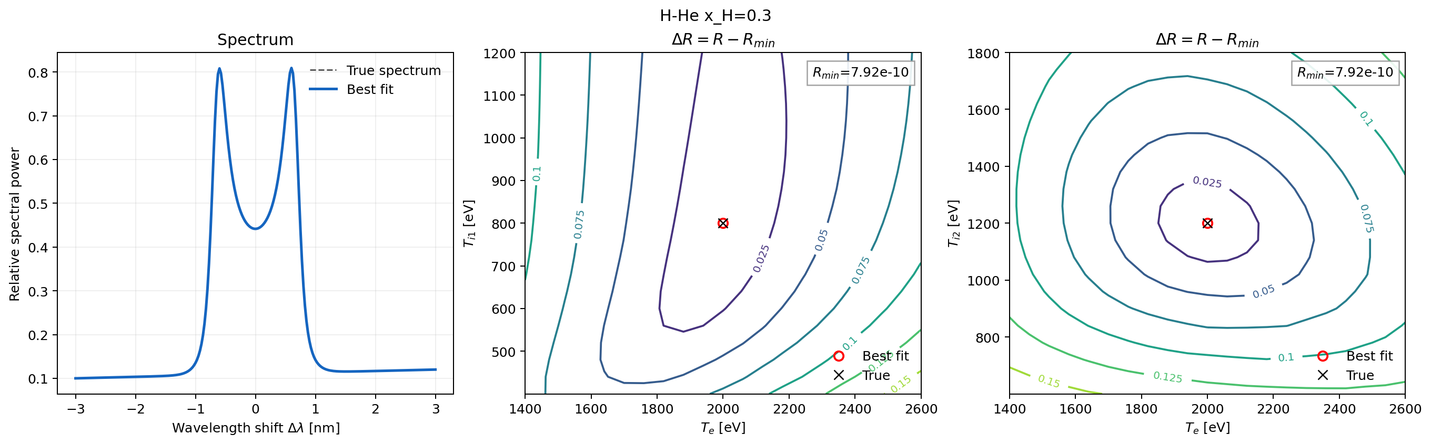

Slide 4
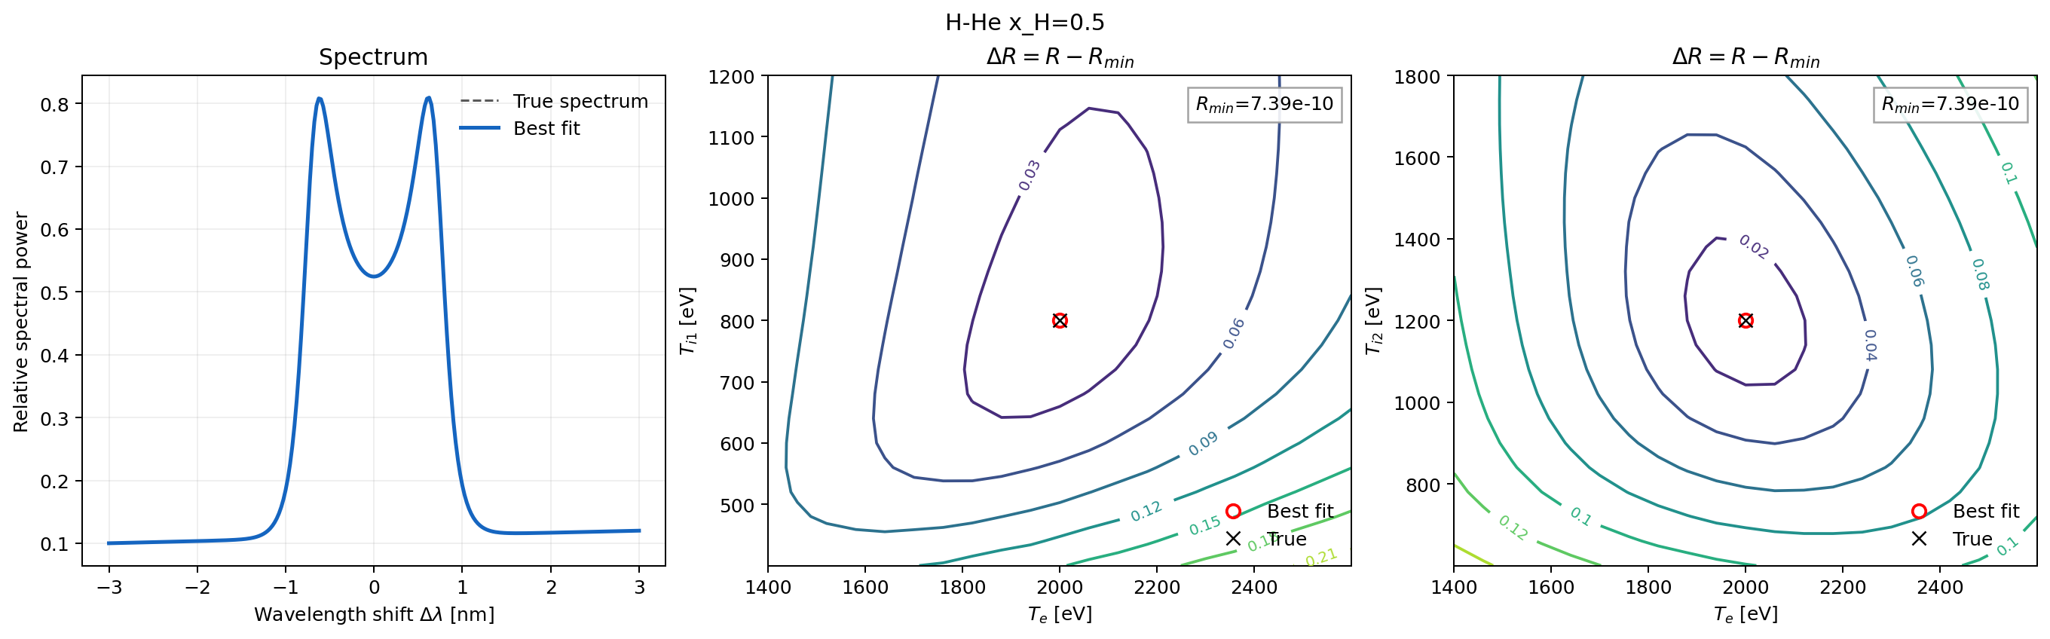

Slide 5
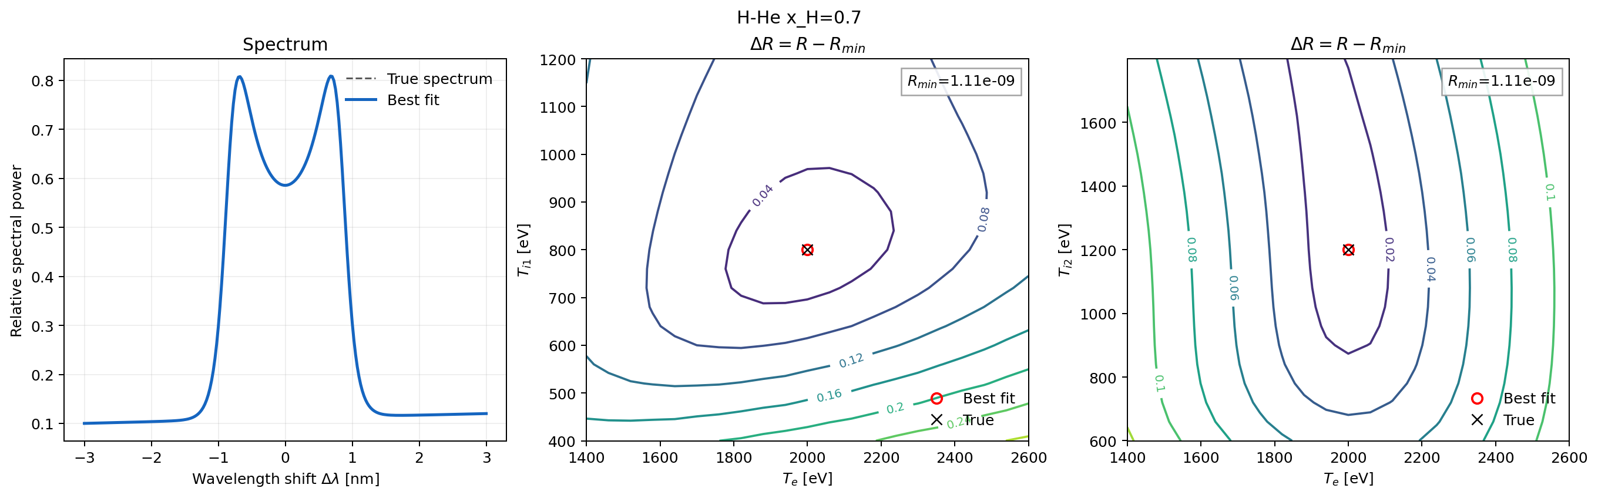

Slide 6
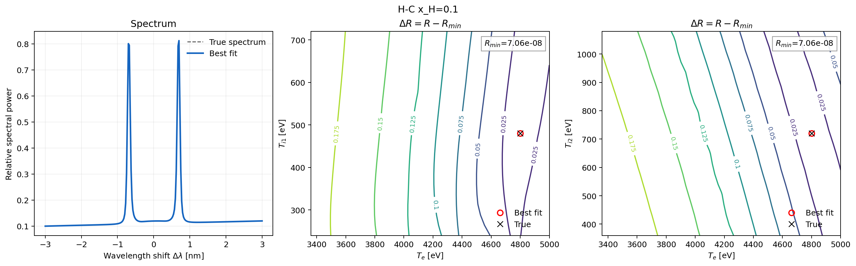

Slide 7
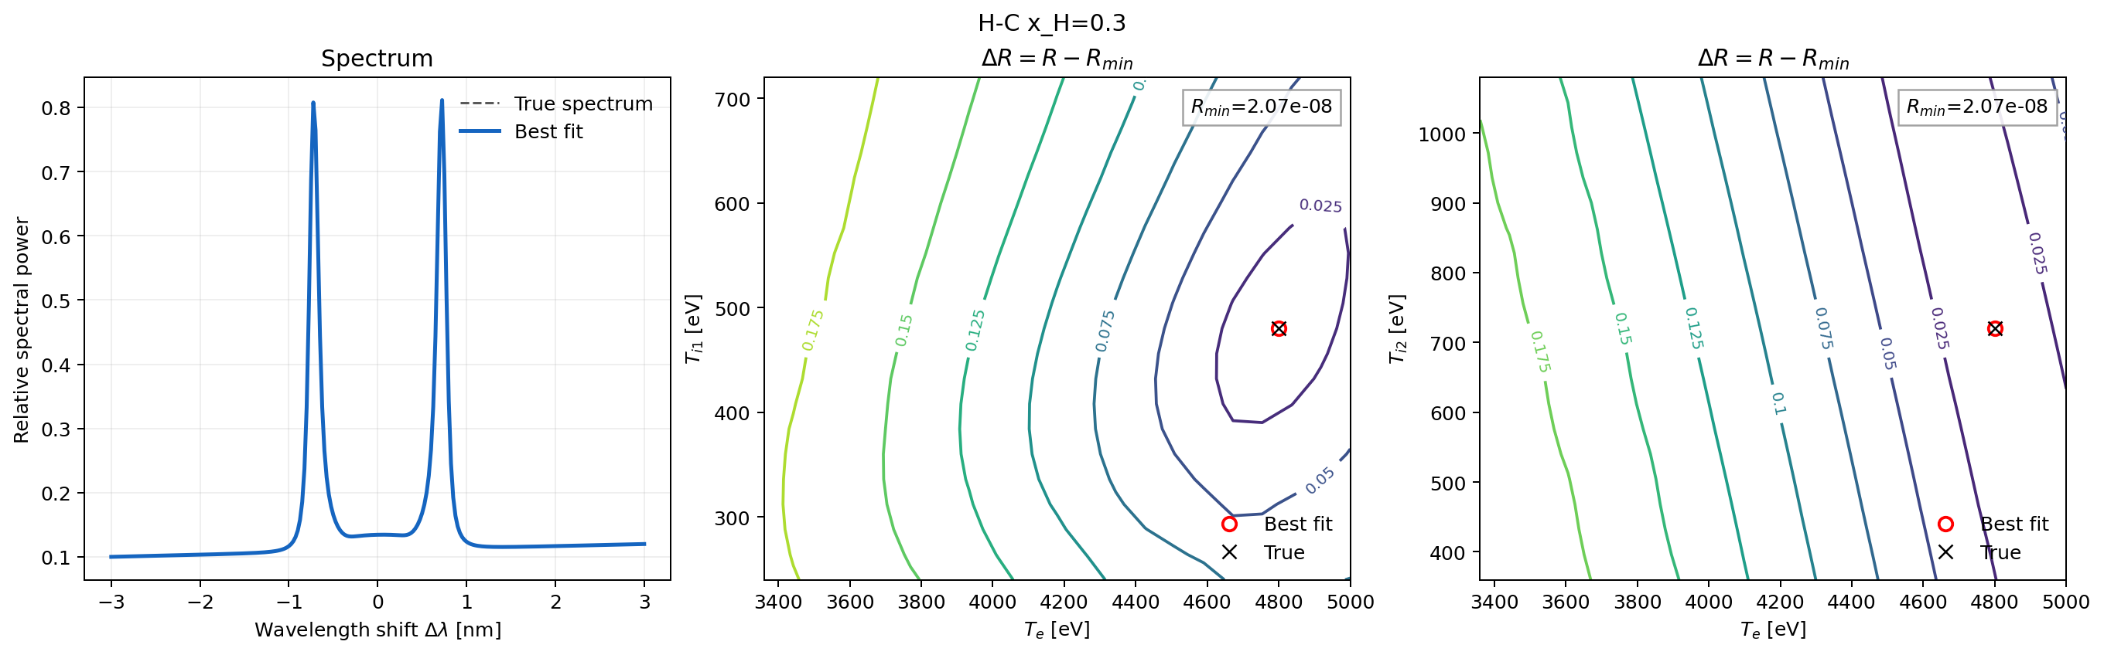

Slide 8
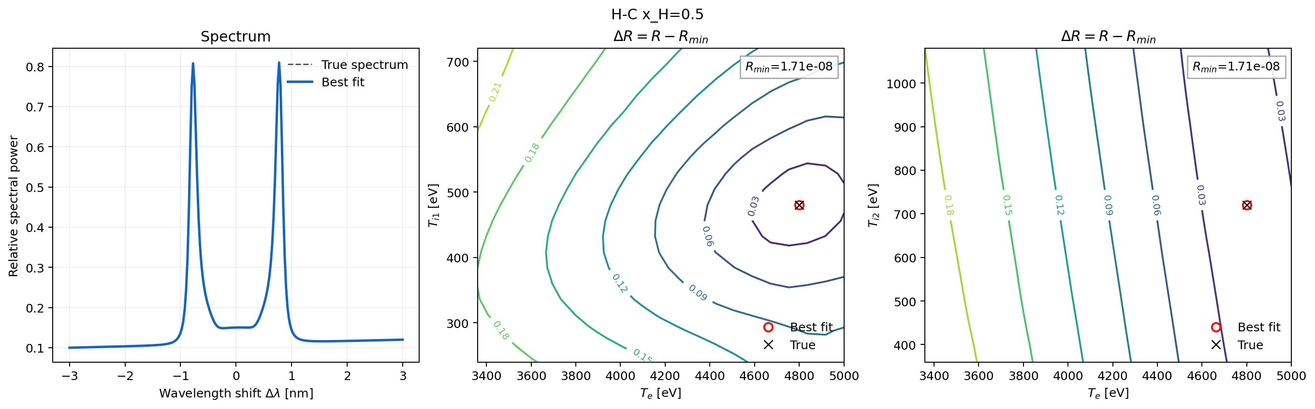

Slide 9
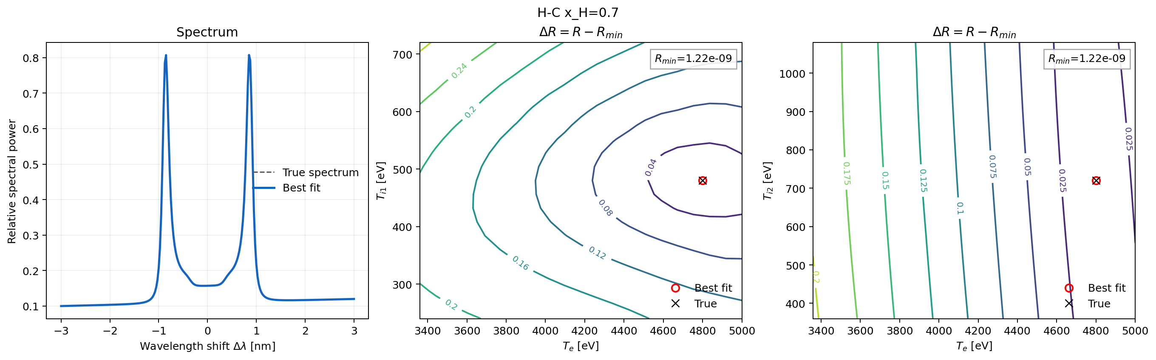

Slide 10
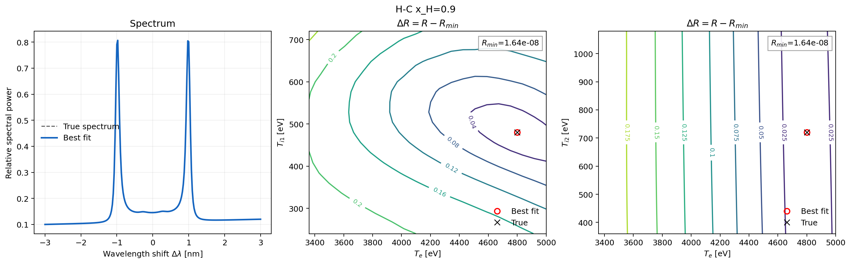

Slide 11
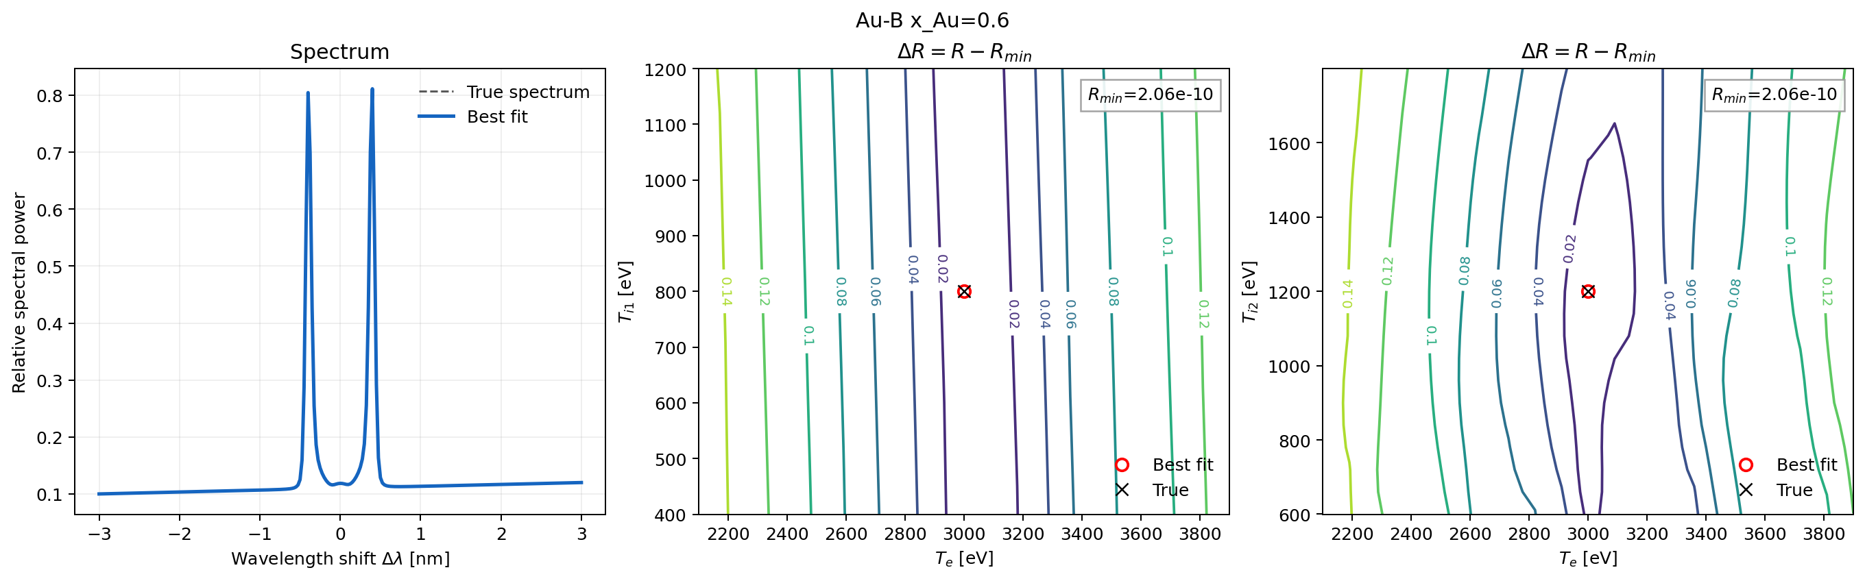

Slide 12
"lm_0": 351.0e-9,
"n_e": 1.81e26,
"Z_i1": 1.0,
"N_i1": 0.55,
"m_i1": PROTON_MASS,
"Z_i2": 6.0,
"N_i2": 0.45,
"m_i2": 12.0 * PROTON_MASS,
T_i1=T_i2=171.3eV
T_e=1370eV

Slide 13
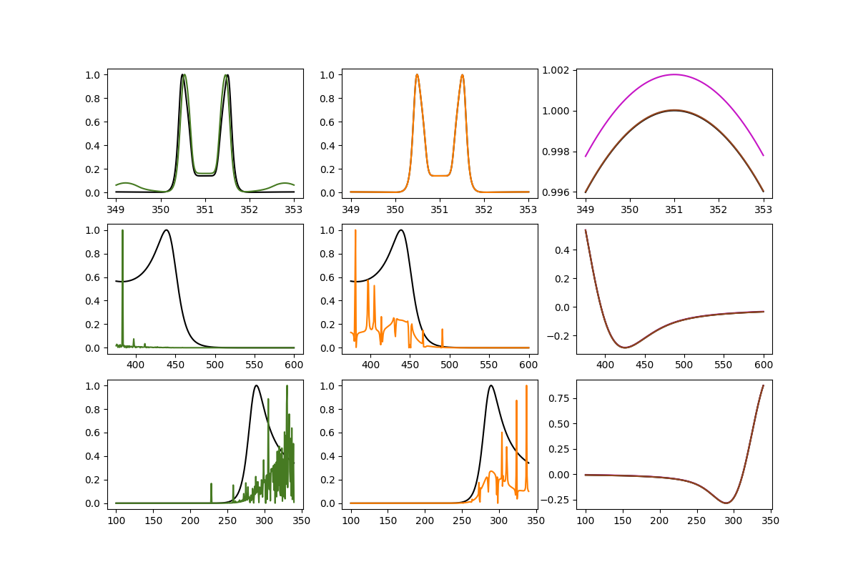
Xe

Slide 14
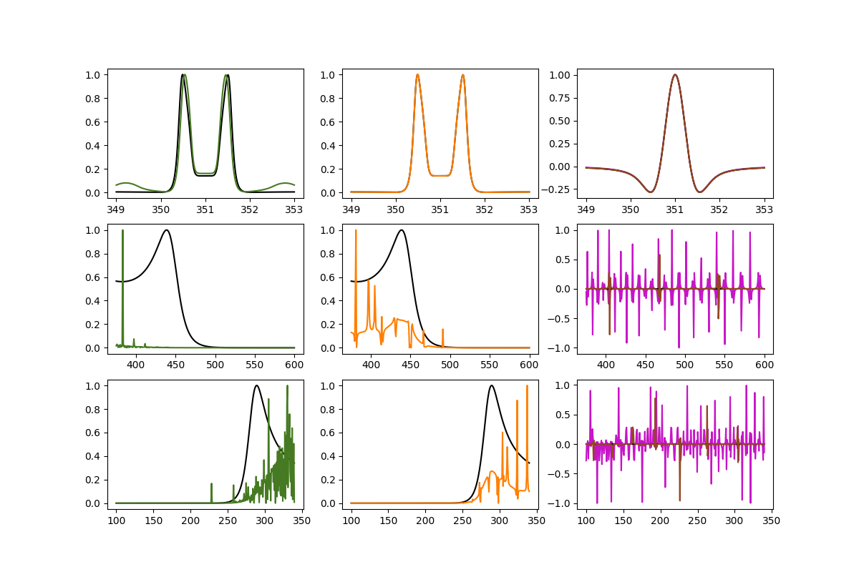
Xh

Slide 15
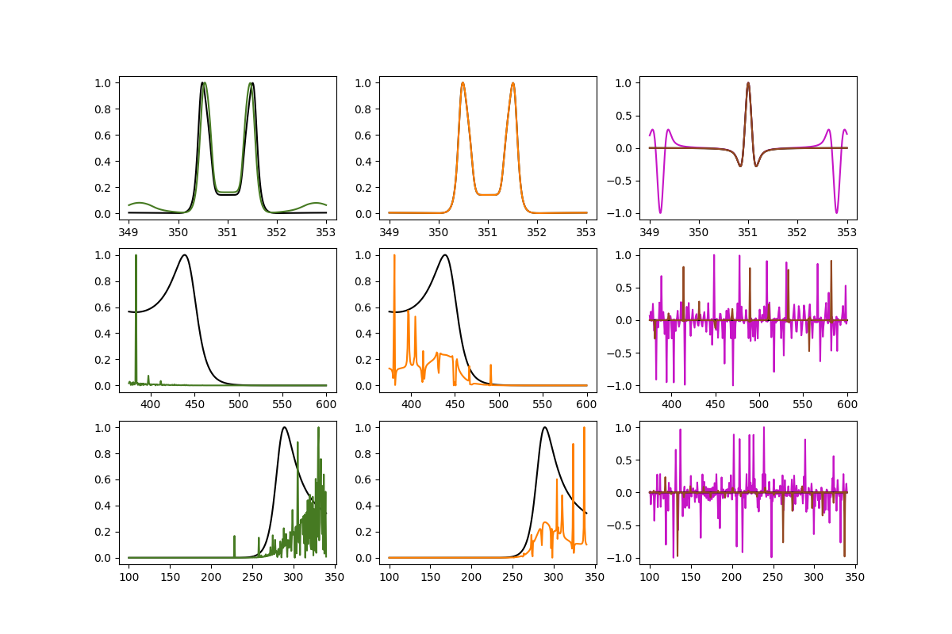
Xc

Slide 16
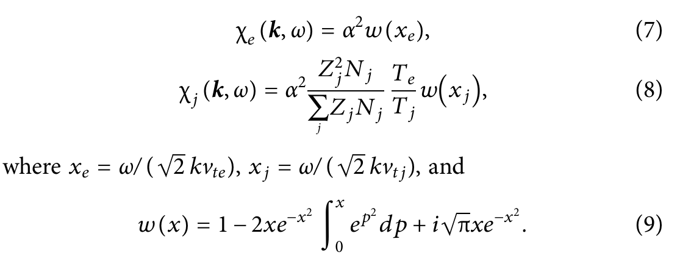
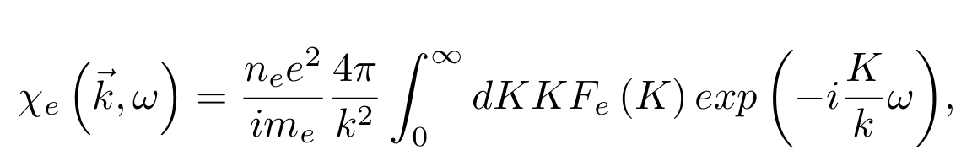
高相速度时Dawson积分趋于0，但Fourier模式为振荡积分！

